Slide 1

Vidyavardhaka College of Engineering
· Department of Computer Science and Engineering
Predictive Container Management for Energy-Efficient Serverless Computing
Major Project — Phase 1
Presented By:
Charan P — 4VV23CS042
Darshan S Gowda — 4VV23CS052
Gaurav S G — 4VV23CS074
Guide: Dr. Tej Hiremat

Slide 2
Overview
Abstract
Problem
Agentic Planning
Evaluation
Serverless computing provisions resources on demand, but cold starts spike latency while idle warm containers waste energy.
Qwen3 interprets predicted demand, system state and SLA status to produce a high-level container-management plan.
The closed-loop system is compared against reactive autoscaling on latency, SLA compliance, cold starts, energy and utilisation.
Data & Forecast
RL Control
Azure Functions traces are preprocessed into time-series sequences; a Temporal Fusion Transformer predicts short-term workload.
A PPO controller executes fast decisions — NoOp, PreWarm, ScaleOut, Reuse, ScaleIn or Terminate — with SLA as the primary constraint.

Slide 3

Problem Statement
The Challenge with Serverless Scaling
Serverless workloads vary rapidly. Reactive scaling responds after demand changes, causing cold-start latency spikes. Keeping containers warm reduces cold starts but inflates idle energy and resource waste.
⏱ Cold-Start Delay
⚡ Idle Energy Waste
New containers require initialisation, adding response latency during demand spikes.
Warm containers kept on standby consume power even when receiving zero invocations.
Core Problem: Anticipate workload changes and autonomously manage containers so energy is minimised without violating SLA requirements.
📉 Reactive Limitation
🔢 Optimisation Target
Threshold-based autoscalers scale too late; sudden spikes breach SLA before action is taken.
Minimise E + αL + βCS + γC subject to P95 latency ≤ SLA target.

Slide 4
Introduction
Context & Motivation
Serverless Growth
Cold-Start Challenge
Reactive Scaling Limit
Event-driven applications create highly variable, burst-prone workloads that challenge traditional provisioning.
A new container must initialise its runtime before serving requests, directly increasing end-user response latency.
Scaling triggered by observed demand arrives too late for sudden spikes, causing SLA breaches at the moment of peak load.
Energy Efficiency Need
Predictive Solution
Excessive warm capacity consumes significant energy during low-demand periods, raising operational cost and carbon footprint.
Combining Transformer forecasting, Qwen3 agentic planning and PPO reinforcement learning enables proactive, autonomous control.

Slide 5
Objectives
Project Objectives & Targets
Workload Forecasting
SLA Protection
01)
04)
Use TFT to predict short-term invocation demand from
multivariate workload and runtime features.
Strongly prioritize P95 latency within the defined SLA
target; violations carry the highest penalty.
Proactive Scaling
Energy Optimization
02)
05)
Prewarm or scale containers before demand arrives,
eliminating reactive cold-start latency.
Reduce unnecessary active and idle container time to
lower overall energy consumption.
Agentic Planning via Qwen3
Rigorous Evaluation
03)
06)
High-level reasoning over forecast, system state and
SLA to generate orchestration plans.
Compare against reactive autoscaling across multiple
workload patterns with clear metrics.
Indicative Targets (not guaranteed results)
15–25% energy consumption reduction
20–30% cold-start count reduction
P95 latency maintained within SLA
Improved CPU & memory utilisation
Reduced over-provisioning

Slide 6

Architecture
Data Pipeline & Model Architecture
Preprocessing
Qwen3 Planning
Dataset Prep
Resample, normalize, encode, add time features
TFT Forecasting
PPO Control
Forecast + state + SLA → high-level plan
Clean and sort Azure Functions traces
State → action: PreWarm/Scale/Reuse/Terminate
30 intervals in → predict next 5–15 min
Data source: Azure Functions workload traces · Key features include invocation count, execution duration, CPU/memory utilisation, container state, cold-start occurrence, response latency and time-of-day indicators.

Slide 7
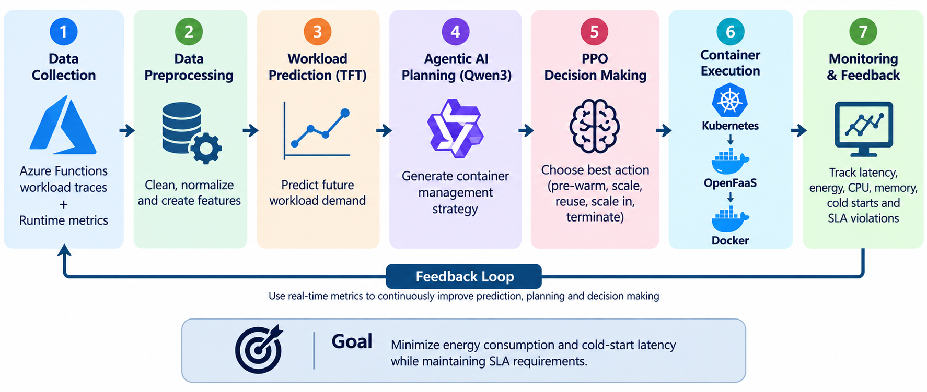
Methodology
System Methodology & Control Loop
Workload Data
Data Preprocessing
TFT Prediction
Agentic Planning

Slide 8
Implementation
Tools & Technologies
The stack integrates state-of-the-art ML frameworks with production-grade cloud-native infrastructure, enabling end-to-end experimentation and real deployment validation.
Category | Tool / Library | Role
Programming | Python | Orchestration, ML/RL pipelines
Data Processing | Pandas, NumPy | Cleaning, resampling, feature engineering
Deep Learning | PyTorch | Model implementation
Prediction | Temporal Fusion Transformer | Workload forecasting
Agentic AI | Qwen3 | High-level planning & reasoning
Reinforcement Learning | PPO | Fast SLA-aware control
Serverless | OpenFaaS | Function execution runtime
Containerisation | Docker | Application containers
Orchestration | Kubernetes | Container lifecycle & scaling
Monitoring | Prometheus + Grafana | Metrics collection & dashboards
Dataset | Azure Functions Traces | Historical workload patterns
Development | Jupyter Notebook / VS Code | Experimentation & implementation
ML / AI Layer
PyTorch · TFT · Qwen3 · PPO
Infrastructure Layer
Kubernetes · OpenFaaS · Docker
Observability Layer
Prometheus · Grafana

Slide 9

Expected Outcomes
Deliverables, Applications & References
📈 Predictive Workload Model
🤖 Autonomous Container Controller
⚡ SLA-Safe Energy Efficiency
Accurate short-term workload forecasts using TFT trained on Azure Functions traces.
Lower energy and cold starts while preserving the P95 latency target. (Targets: 15–25% energy, 20–30% cold-start reduction.)
Proactive, adaptive lifecycle decisions driven by Qwen3 planning and PPO control.
☁ Cloud-Native Prototype
📊 Evaluation & Documentation
Kubernetes/OpenFaaS/Docker implementation with Prometheus and Grafana monitoring dashboards.
Baseline comparison, ablation study, full metrics/graphs and final project report.
Example: During an e-commerce flash sale, TFT predicts a spike → Qwen3 plans prewarming → PPO selects the exact action → warm containers handle demand → as demand drops, the system scales in to save energy.
Key References: (1) IEEE TNSM 2025 — DOI 10.1109/TNSM.2024.3497155 · (2) IEEE TSC 2025 — DOI 10.1109/TSC.2025.3596887 · (3) IEEE TC 2024 — DOI 10.1109/TC.2024.3386063 · (4) IEEE IPDPS 2024 — DOI 10.1109/IPDPS57955.2024.00017 · (5) IEEE TNSE 2026 — DOI 10.1109/TNSE.2026.3691933

Slide 10

Thank You

